Slide 1

AI & ML Laboratory Project on Predicting Weather Patterns
Pavan Kalyan (2203A51356)
- UNDER THE GUIDANCE OF
Dr .Soumik Podder
School of Computer Science & Artificial Intelligence
SR University
2024
/

Slide 2
Plan of Talk
ABSTRACT
INTRODUCTION
PROPOSED SOLUTION
FLOW CHART
RESULT AND DISCUSSION
CONCLUSION

Slide 3
ABSTRACT
This project focuses on improving climate assessment and forecasting using machine learning, which is important due to the limitations of traditional methods in accurately predicting environmental changes.
Treating the environment as a liquid for assessment
Observing current wind conditions
Using machine learning to overcome uncertainties and improve forecast accuracy
This project is helpful for real-life applications because it addresses the shortcomings of traditional climate assessment methods and offers a more reliable alternative. By using machine learning, which is less affected by uncertainties and does not depend on physical laws, the project aims to enhance climate forecasting capabilities, potentially leading to more accurate and longer-term predictions.

Slide 4
INTRODUCTION
Weather prediction traditionally relied on physical equations treating the atmosphere as a fluid. However, accurate forecasts beyond 10 days remain challenging.
Machine learning offers a promising approach to improving weather prediction by processing historical forecasts and observations, leading to more accurate models.
Temperature prediction is crucial for various applications, including climate studies, energy management, agriculture, and healthcare.
Machine learning algorithms such as Linear Regression, Polynomial Regression, Random Forest Regression, Artificial Neural Network, and K-nearest neighbor can be used to predict weather variables like minimum temperature, maximum temperature, mean air pressure, and humidity.
By inputting historical data, machine learning models can predict minimum and maximum temperatures for up to 7 days, helping improve long-term weather forecasting accuracy.

Slide 5
PROPOSED Solution
Traditional weather forecasting relies on physics-based simulations, while machine learning algorithms like Linear Regression, K-nearest neighbor, and Random Forest Regression offer an alternative approach with high accuracy and predictivity.
The dataset used in this project is "Historical Weather Data for Indian Cities" from Kaggle, focusing on Kanpur City, collected using the worldweatheronline.com API.
This dataset, spanning over 10 years, can be used for visualizing the impact of global warming and predicting weather for upcoming periods.
Machine learning algorithms are trained on 80% of the data and tested on the remaining 20% to predict temperature changes accurately.
The project aims to predict temperature changes in Kanpur city using machine learning algorithms, offering insights into climate trends and enhancing weather forecasting capabilities to prevent disasters like hurricanes, tornadoes, and thunderstorms.

Slide 6
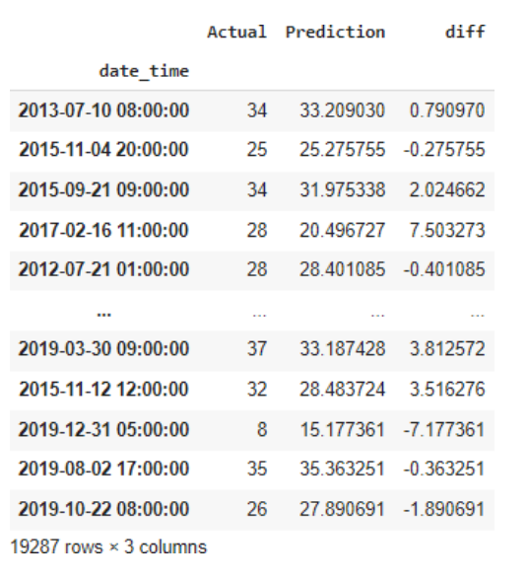
Results and Discussion
Multiple Linear Regression: This model showed a high mean absolute error, indicating lower accuracy compared to other models.

Slide 7
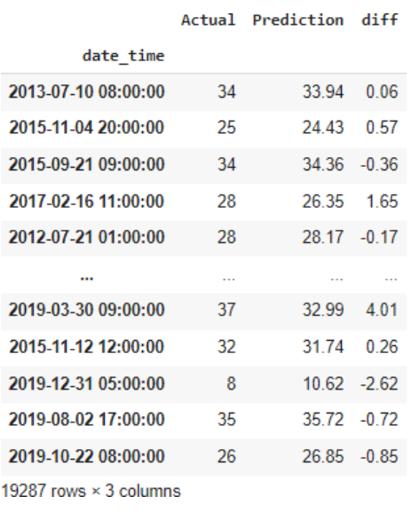
Random Forest Regression: This model demonstrated a low mean absolute error, indicating higher accuracy compared to the other models.

Slide 8
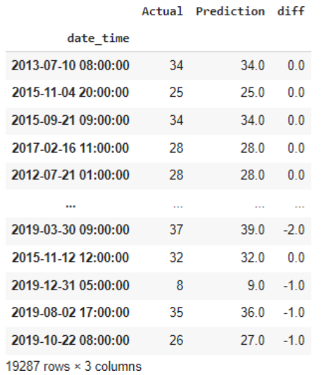
K-nearest Neighbor Regression: This model exhibited a moderate mean absolute error, suggesting moderate accuracy. Overall, the Random Forest Regression model performed the best among the three, showing the lowest mean absolute error and thus the highest accuracy in predicting temperature changes for Kanpur city.

Slide 9
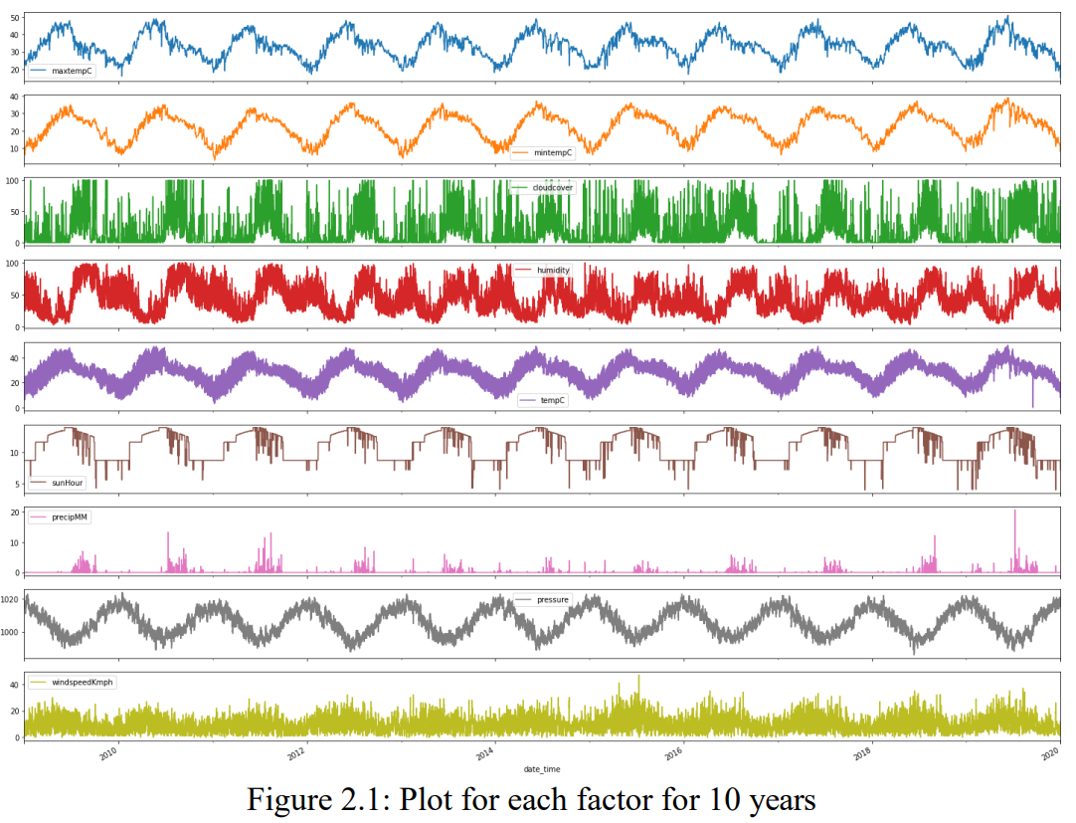
.

Slide 10
CONCLUSION
Expert climate determining apparatuses initially outperformed all machine learning models, but over time, the error in our models reduced significantly, indicating potential for long-term superiority.
Linear regression showed low bias and high variance, while polynomial regression exhibited high bias and low variance.
Linear regression's high variance can be improved by gathering more data, while the bias of polynomial regression suggests its predictions may not benefit from additional data.
Practical regression showed high bias, possibly due to its reliance on the weather of the previous two days, which may not capture longer trends. Future work could explore using more historical data to reduce bias.
Random Forest Regression emerged as the most accurate model, likely due to its popularity for its high accuracy and versatility.
Weather forecasting faces the challenge of predicting precise outcomes due to the complex nature of parameters, each with different ranges of values. This forecasting is crucial for various industries like power facilities, airports, and tourism centers.

Slide 11
GIT HUB Link and LINKDIN LINK
https://github.com/pavankalyan003

Slide 12
References
Kanpur Weather Data (kaggle.com)

